Slide 1

INFO 5100 Utility Management
Thomas Addaquay(002983788)/Angie Liu(002706821)/Vatsal Kapadia(002747692)

Slide 2
INTRODUCTION
This application is a software system for managing personal & financial information between banks, utility companies, local governments & digital wallet.
The purpose of this application is to help connect and maintain personal information across different organizations so that each individual’s information will be updated in different organizations.
The project leverages what has been learned in 5100 classrooms: UML, system design, packaging, database, etc.
The project ensure the independence of functions in the file and reduce the coupling between the components. Independent management of administrators and teachers is realized.

Slide 3
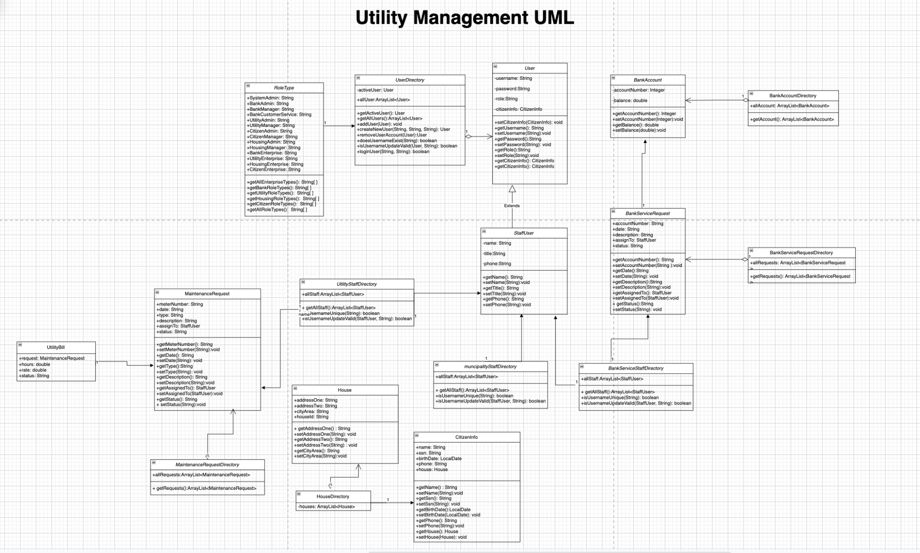
SYSTEM UML CLASS DIAGRAM

Slide 4
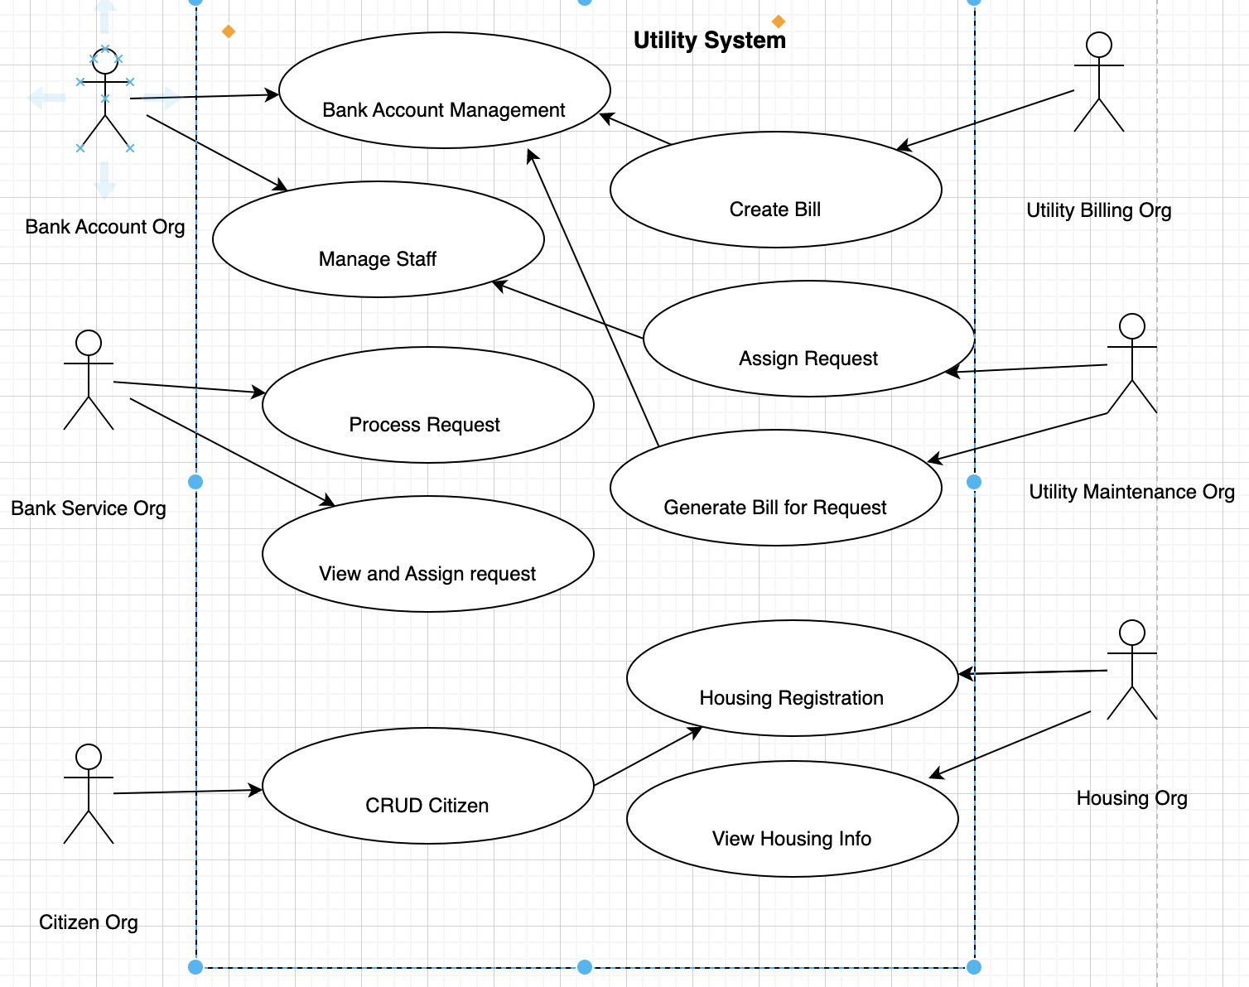
SYSTEM UML SEQUENCE DIAGRAM

Slide 5
TECH STACK
1
SQLite
Read and store data
2
Java Swing
Create user interface to better interact with users with GUI component Swing
Design pattern
UML: visual representation of a system's major roles, actions, and classes in order to enhance understanding, alter and maintain it
3
4
OOD
Using inheritance, encapsulation, polymorphism, etc., and follow OOD design principles.
5
Github/Git
Team collaboration and version control
6
Exception Handling
Exception handling for program runtime

Slide 6
SYSTEM STRUCTURE
Bank
Utility
Citizen
Housing
Bank Account
Billing
Citizen
Housing
Bank Service
maintenance
Citizen Admin
Housing Admin
Bank Manager
Utilities Admin
Citizen Manager
Housing Admin
Bank Admin
Utilities Manager
Bank Customer Service
Customer

Slide 7

3-RD PARTY PACKAGE
SQLite
Database created, tables defined, rows inserted and changed, queries run, and SQLite database files managed with this program.

Slide 8
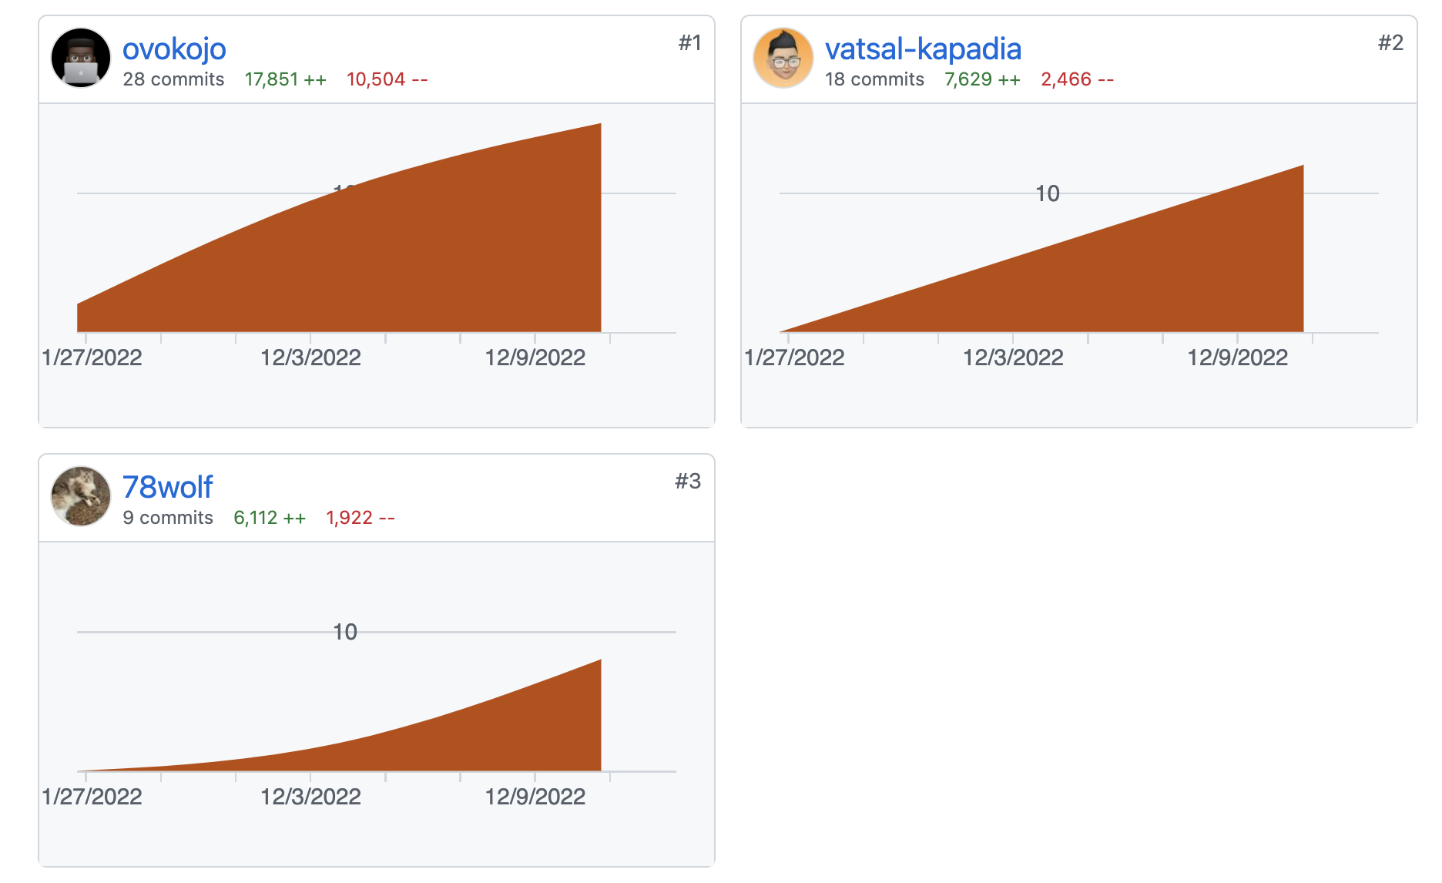
CONTRIBUTION
Angie Liu: Create UML diagrams and PTT

Slide 9
REFERENCE
1.https://docs.oracle.com/en/java/
2.https://docs.oracle.com/javase/7/docs/api/java/awt/package-summary.html3.https://expressjs.com/en/5x/api.html
4.https://www.javatpoint.com/java-swing
5.https://brew.sh/
6.https://stackify.com/solid-design-principles/
7.https://developer.mozilla.org/en-US/docs/Glossary/MVC
8.https://docs.github.com/en
9https://blog.bytebytego.com/p/ep28-the-payments-ecosystem-also?utm_source=profile&utm_medium=reader2
10.https://www.baeldung.com/java-csv
11.https://www.sqlite.org/index.html
12.https://www.baeldung.com/opencsv
13.https://www.simplilearn.com/tutorials/java-tutorial/thread-in-java
15.https://www.edureka.co/blog/java-jframe/
16.https://www.digitalocean.com/community/conceptual-articles/s-o-l-i-d-the-first-five-principles-of-object-oriented-design
17.https://www.collinsdictionary.com/us/dictionary/english/ood18.
19.https://www.geeksforgeeks.org/runnable-interface-in-java/
20.https://docs.oracle.com/javase/tutorial/java/javaOO/lambdaexpressions.html

Slide 10

THANK YOU

